Slide 1
Industry Academia Collaborations
Rudy Rizkalla, PharmD
Medical Science Liaison – Lung Oncology
Friday, August 23, 2024
The information is not to be copied or distributed in any manner or format.

Slide 2
Disclaimer
The information contained in this slide deck is for information purposes only based on unsolicited requests from physicians.
The information is not to be copied or distributed in any manner or format.
AstraZeneca does not, under any circumstances, promote its products for off-label or unapproved uses.

Slide 3
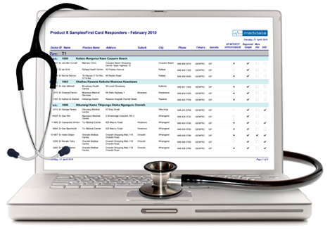
Types of research a typical pharma company conducts
Principles
Scientific rigour
1
Medical Evidence
2
Collaborative
3
Knowledge translation
4
Data privacy
Company-sponsored clinical trials
Externally Sponsored Research (ESR) – also called IITs
Real World Evidence (RWE)
The information is not to be copied or distributed in any manner or format.

Slide 4
Globally Sponsored Trials
Company or CRO run
AstraZeneca Canada Oncology data
– Over 100 ongoing trials in 2024
Almost 250 trials in past 5 years in Canada
380 sites, 1400 patients enrolled, over 700 patients randomized
Trials in following tumour areas
Lung
Breast
GI – liver, pancreatic
GU - prostate
H&N
Mesothelioma
Gyne – ovarian, endometrial
Heme
Global Oncology Clinical Trial Hub in Toronto
The information is not to be copied or distributed in any manner or format.

Slide 5
Externally Sponsored Research (or Investigator-Initiated Trials) (1)
Can be Unsolicited Individual Investigator Proposals
Company delegates all sponsor responsibilities to Investigator
Design of trial, analysis and results belong to the Investigator
Normally small number of sites involved
The information is not to be copied or distributed in any manner or format.

Slide 6
Externally Sponsored Research (or Investigator-Initiated Trials) (2)
Can be with Collaborative/Academic Groups
Company and Collaborative group agree on design, results belong to Collaborative group
Can be larger in scale compared to single center ESRs
Often are randomized Ph II/ III with international participation
The information is not to be copied or distributed in any manner or format.

Slide 7
Real World Evidence
Industry sponsored or in collaboration with Investigators
RWE becoming more important to payers and regulatory authorities
The information is not to be copied or distributed in any manner or format.

